Slide 1
Chapter 2
Basic Operations

Slide 2
Overview
SQI_{SIGN} involves the connection between two mathematical concepts that seem unrelated:
1) Isogenies between supersingular elliptic curves over finite fields
2) Maximal orders and ideals of quaternion algebras

Slide 3
Section 2.1 - Finite Fields
A field is a relatively well-equipped algebraic structure. As a review, we can build up to it from more fundamental structures

Slide 4
Abelian group
Set Magma Semigroup Monoid
Abelian group Group

Slide 5
Field
(S, +)
a(b + c) = ab + ac (F, +, x)
(S \ {0}, x)

Slide 6
Example
An example is ℚ, the rational numbers (set of fractions with integer numerator and denominator (den ≠ 0))
Closure: Sum or multiplication of rational numbers is rational
Associativity: A sequence of addition operations can be done in any order (similarly for multiplication)
Identity: Additive identity: 0; Multiplicative identity: 1
Inverse: Can simply negate a number to get its additive inverse; Can flip a fraction to get its multiplicative inverse (remember 0 is not included here)
Commutativity: Can add or multiply two rationals in any order

Slide 7
Finite fields
We care about fields with a finite number of elements. All such fields are of prime power order (powers of a single prime). Specifically we care about F_{p} (operations are mod p) and F_{p^2} which both have characteristic p.
Ex. F_{p} = (ℤ_{p}, +, x) has characteristic p because 1 + 1 + 1 + … + 1 = 0 (mod p)
p times
We will consider p = 3 (mod 4)

Slide 8
Quadratic residue in F_{p}
Useful for later definitions throughout the paper
A number congruent to a perfect square: b² = a (mod p)
Can test if ‘a’ is a perfect square in F_{p} by raising both sides by (p - 1) / 2
b^{p-1} = a^{(p-1)/2} (mod p) = 1 (mod p) (by Fermat’s little theorem)
If this equation is not true, then ‘a’ wasn’t a perfect square to begin with

Slide 9
F_{q} for q = p²
If F_{p} was analogous to the real numbers, then F_{p^2} is analogous to the complex numbers. With i² + 1 = 0, elements of F_{p^2} are of the form a₀ + a₁i for a₀, a₁ in F_{p}
It’s additive and multiplicative operations are the familiar ones when working with complex numbers. For instance, the multiplicative inverse of a + bi is:
1 1 (a-bi) a-bi
a + bi a+ bi (a-bi) a² + b²

Slide 10
Section 2.2 - Elliptic Curves
Montgomery elliptic curves are curves of the form: By² = x³ + Ax² + x
We also importantly consider a “point at infinity”, ∞, to be part of the curve
Two curves are isomorphic if there is a bijective (one-to-one correspondence) mapping between them of the form (x, y) (D(x + R), Cy)
They are “quadratic twists” of one another if C = √(B/B’) and are isomorphic if B/B’ is a perfect square

Slide 11
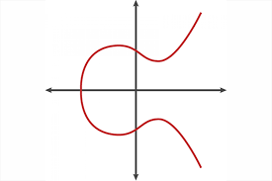
Elliptic curve over the real numbers

Slide 12
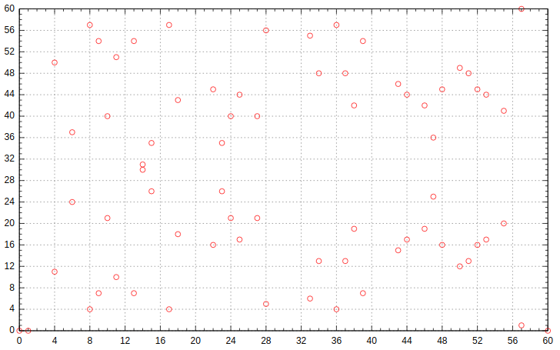
An elliptic curve over the finite field, F₆₁

Slide 13
Supersingular meaning
If the number of solutions to the curve is congruent to 1 mod char(F_{q}), it is called supersingular.
Recall we care about p = 3 (mod 4) and F_{p^2}
In this case, if B = 1, the curve has exactly (p + 1)² points
Ex. B = 1, p = 7, (7 + 1)² = 64 mod 7 = 1 (mod 7) ✓

Slide 14
Group structure of elliptic curves
Collectively supplementing the points on the elliptic curve with a binary addition operation yields an abelian group!
Define the additive identity to be the point at infinity, ∞. So, for a point P on the elliptic curve, P + ∞ = ∞ + P = P.
To add two points on the curve, draw a line of intersection through the points. The third point of intersection is defined as the negation of the sum of the points. This is because we define the sum of three points of intersection on a line as ∞.
To get the correct sum, reflect this point over the x-axis.
Note the third point may be ∞ if the line is vertical

Slide 15
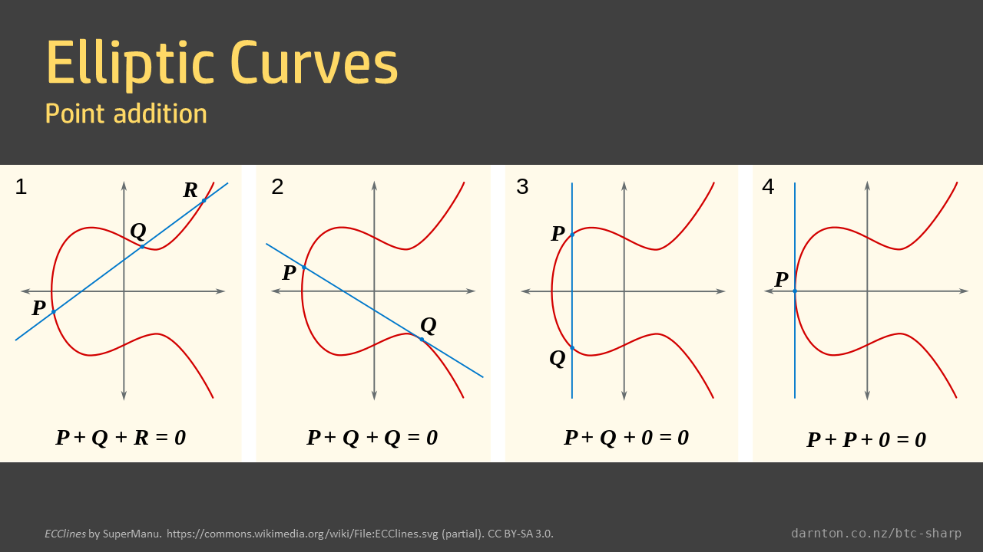

Slide 16
Abelian Group properties hold
Closure: The sum of two points on the curve is also a point on the curve
Associativity: Harder to show but is true
Identity: ∞
Inverse: Point reflected over x-axis is a point’s inverse
Commutativity: The order in which you add points doesn’t matter

Slide 17
Discrete logarithm problem
Scalar multiplication can be defined using repeated point doubling and addition
It is denoted: [k]P
Since we are dealing with repeated applications of an abelian group’s operation, we can naturally define a discrete log problem:
Given a point P and a scalar multiple [k]P, find k
Now knowing how “strangely” addition works and how unrelated the sum of points seem to the original points, you can imagine how difficult solving the discrete log problem will be for large k

Slide 18
Solvability
For certain points, this is difficult for classical computers (they basically need to do an exhaustive search)
But for other choices of points it is efficiently solvable
However, this is the background required to understand the paper’s work with elliptic curves

